Slide 1



Assignment-6
Web Programming
Student: Shukirillaev Mukhammad Sodik Sherzodbek Ugli
Department:Computer Engineering

Slide 2
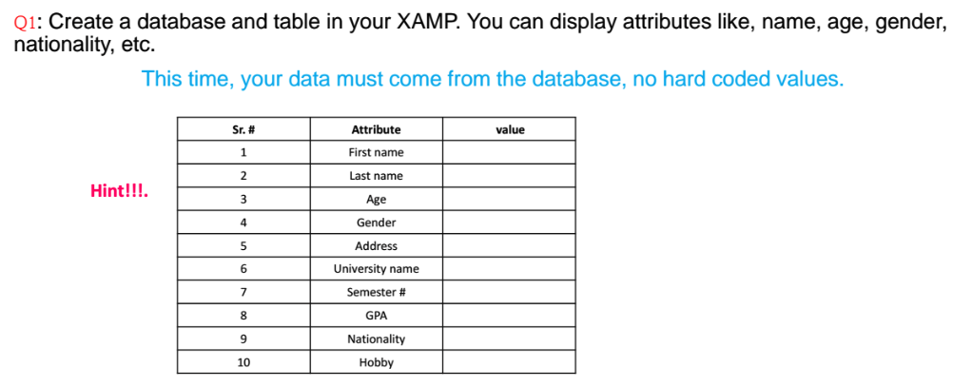
Question 1:

Slide 3
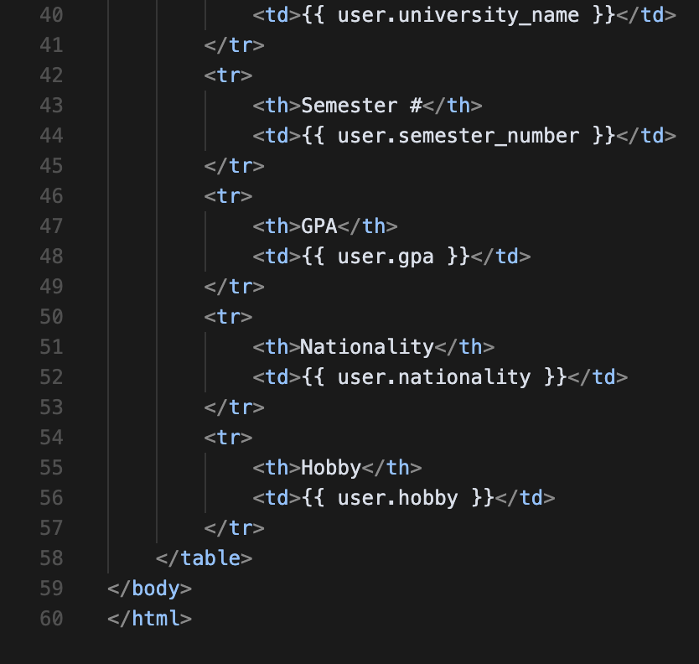
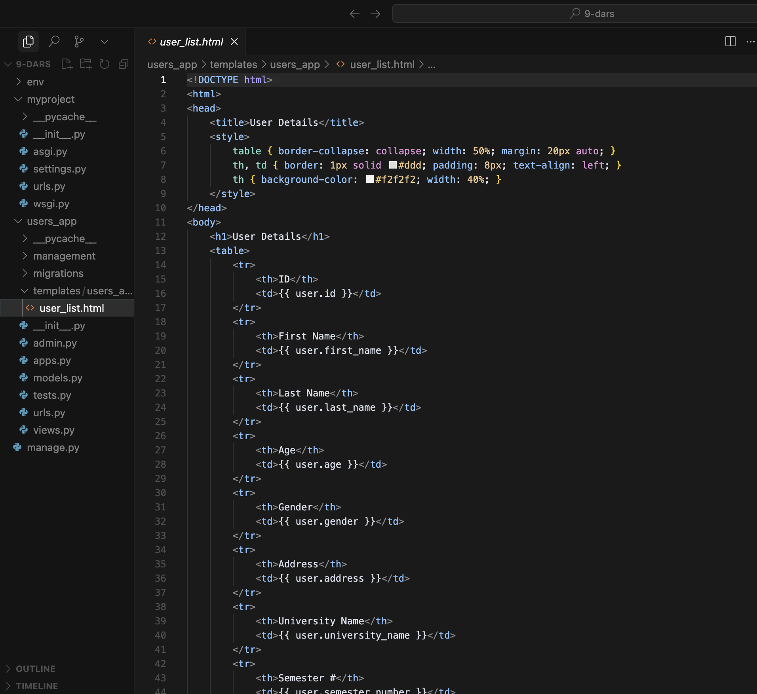
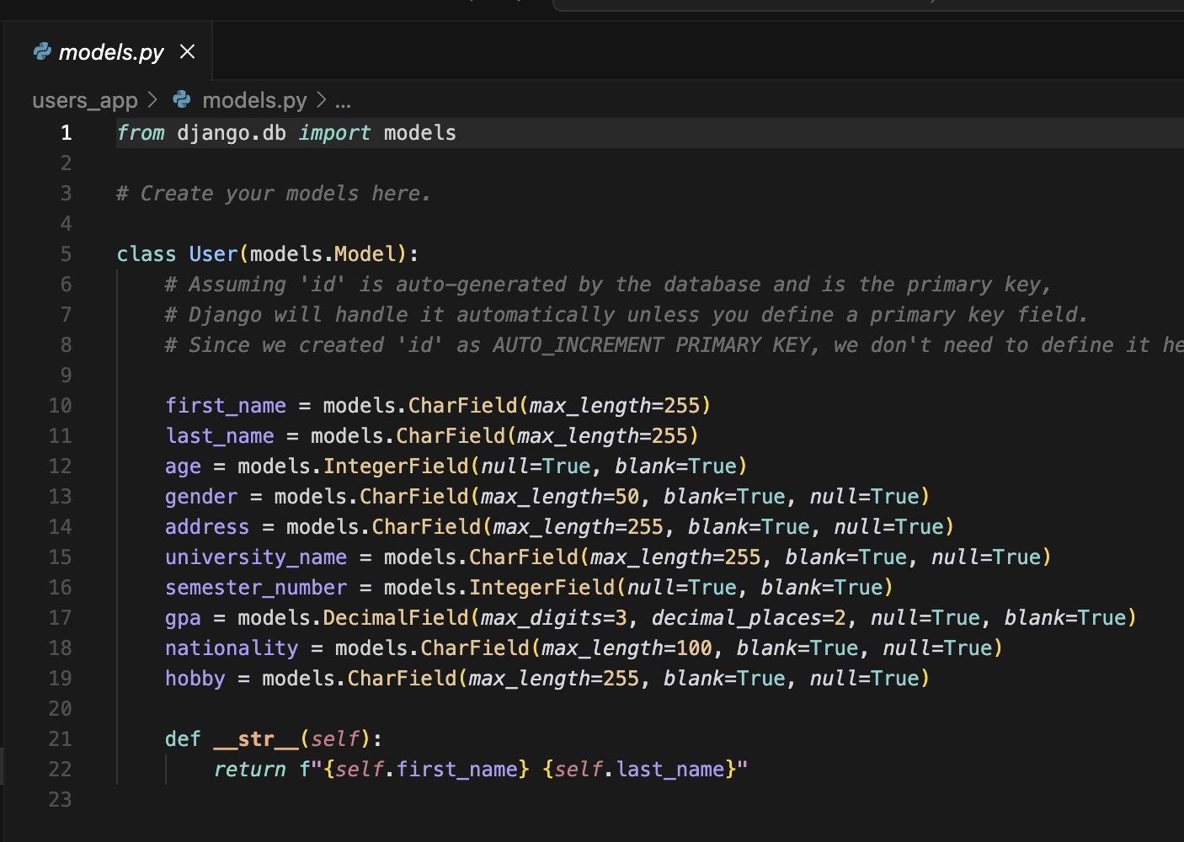
Code:
https://github.com/McLight-Note/Web-Programming-UNI/tree/main/Assignments/9-dars
Here is the Github for all the codes, need to take a lot of screenshots. Instead i posted a link here!

Slide 4
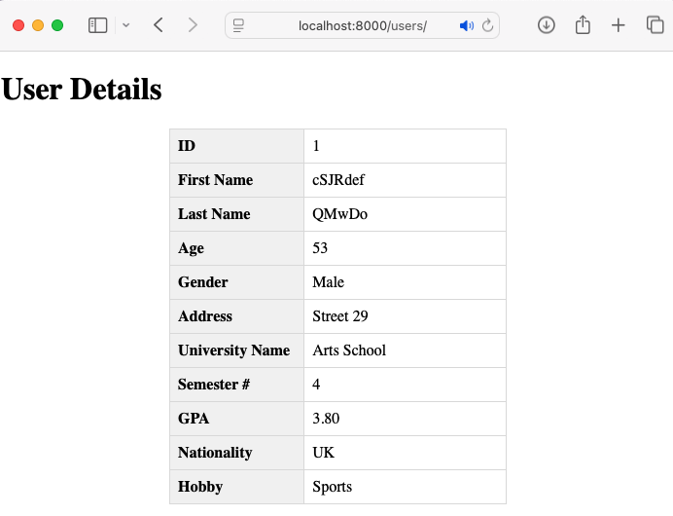
Result

Slide 5
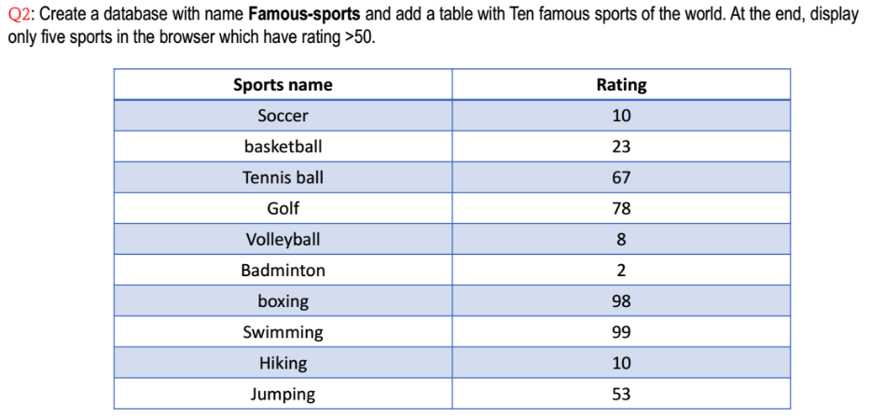
Question 2:

Slide 6
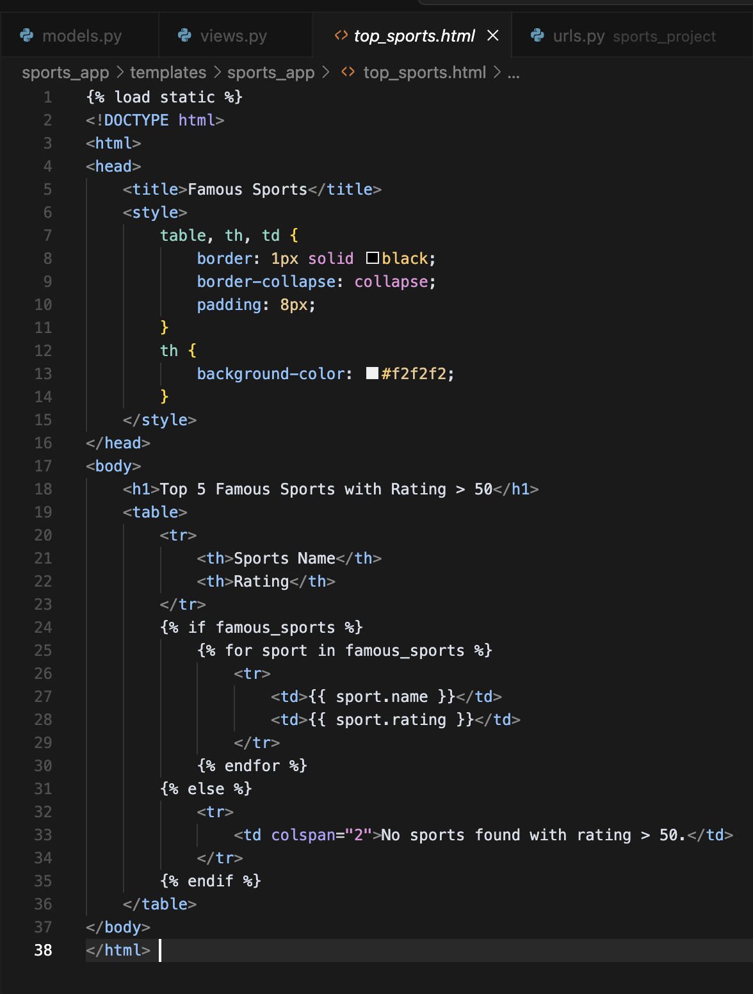
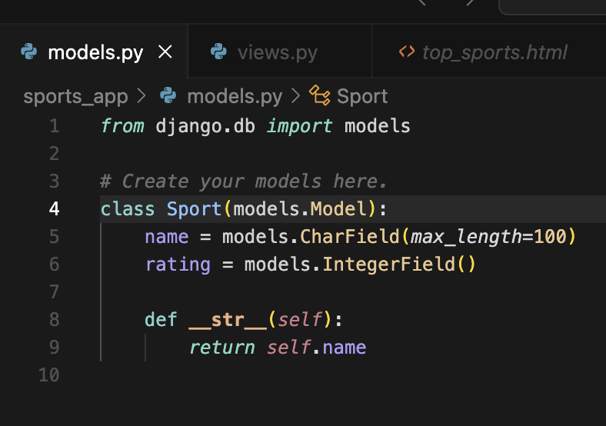
Code:
https://github.com/McLight-Note/Web-Programming-UNI/tree/main/Assignments/9-1_dars
Here is the Github for all the codes, need to take a lot of screenshots. Instead i posted a link here!

Slide 7
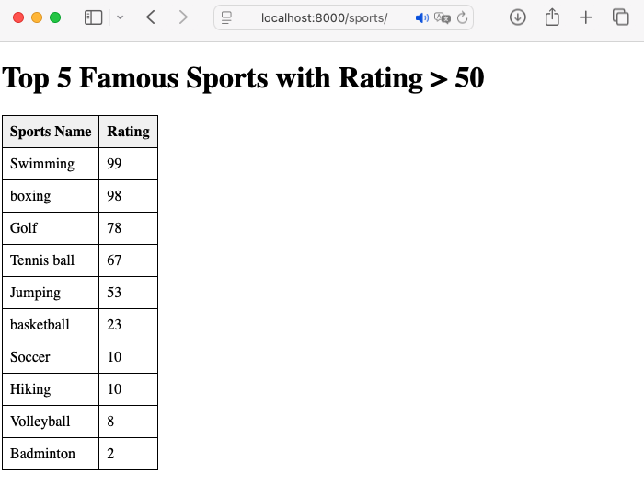
Result

Slide 8
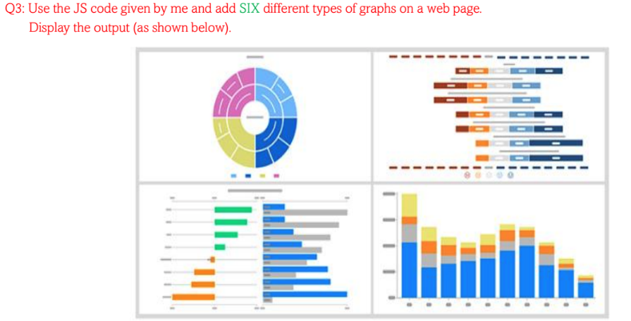
Question 3:

Slide 9
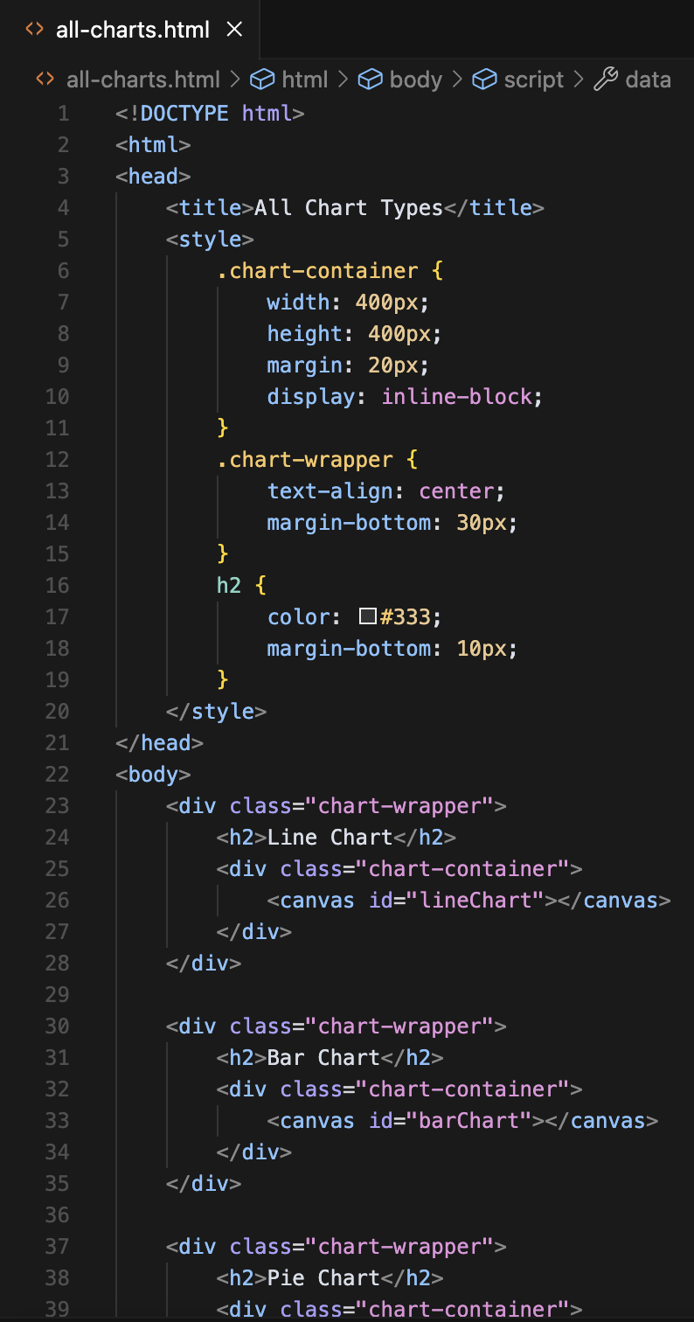
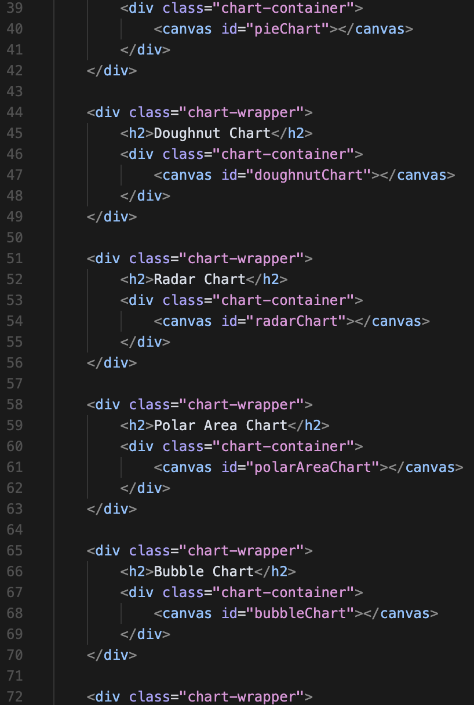
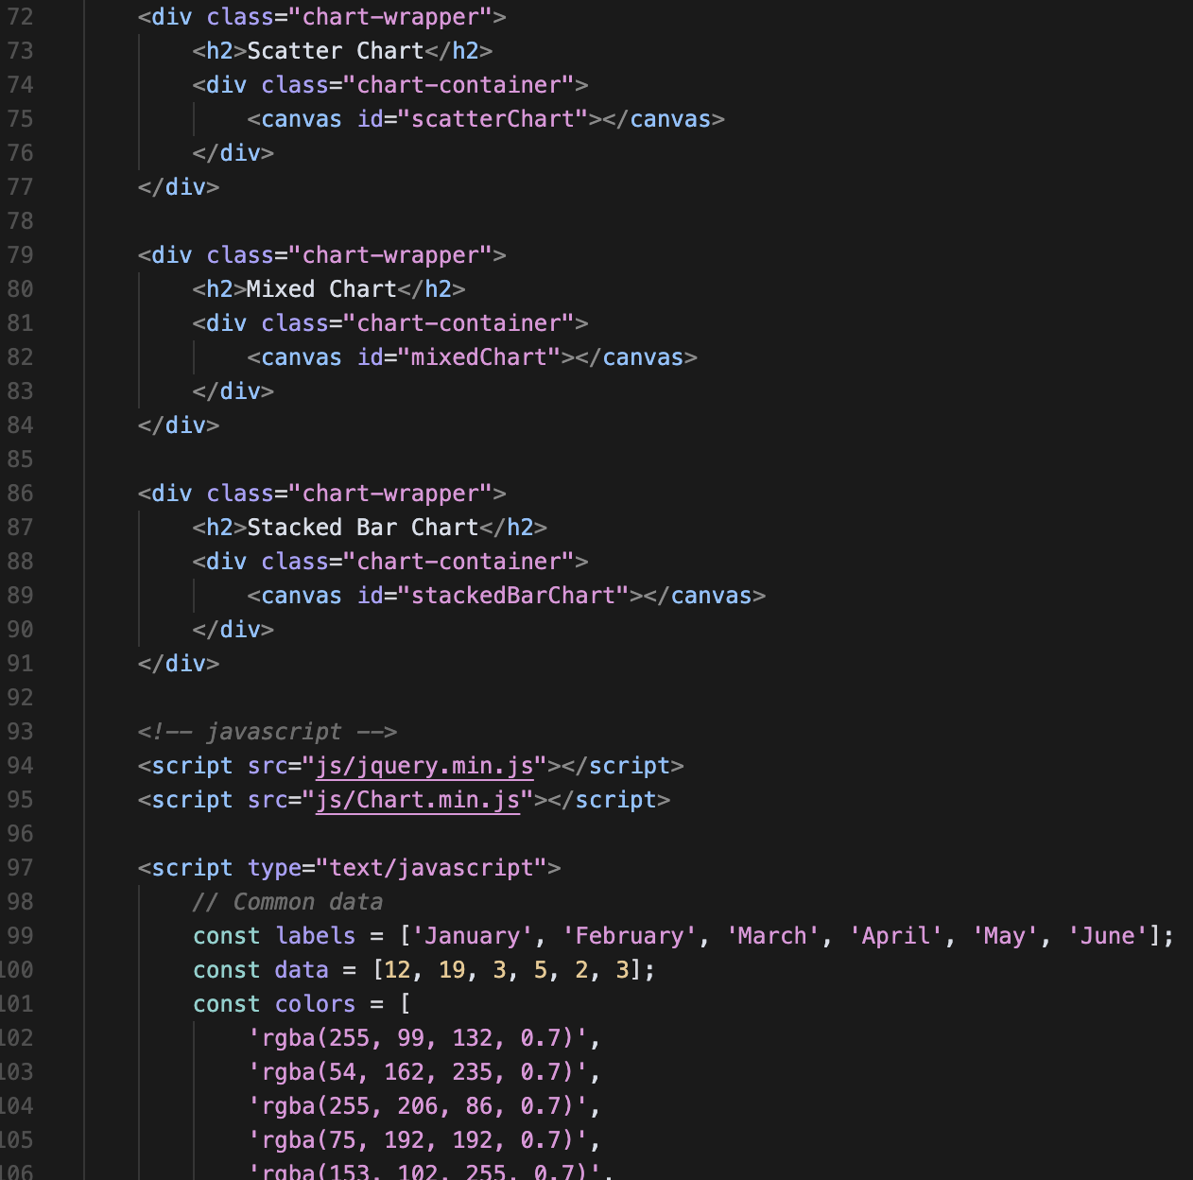
Code:

Slide 10
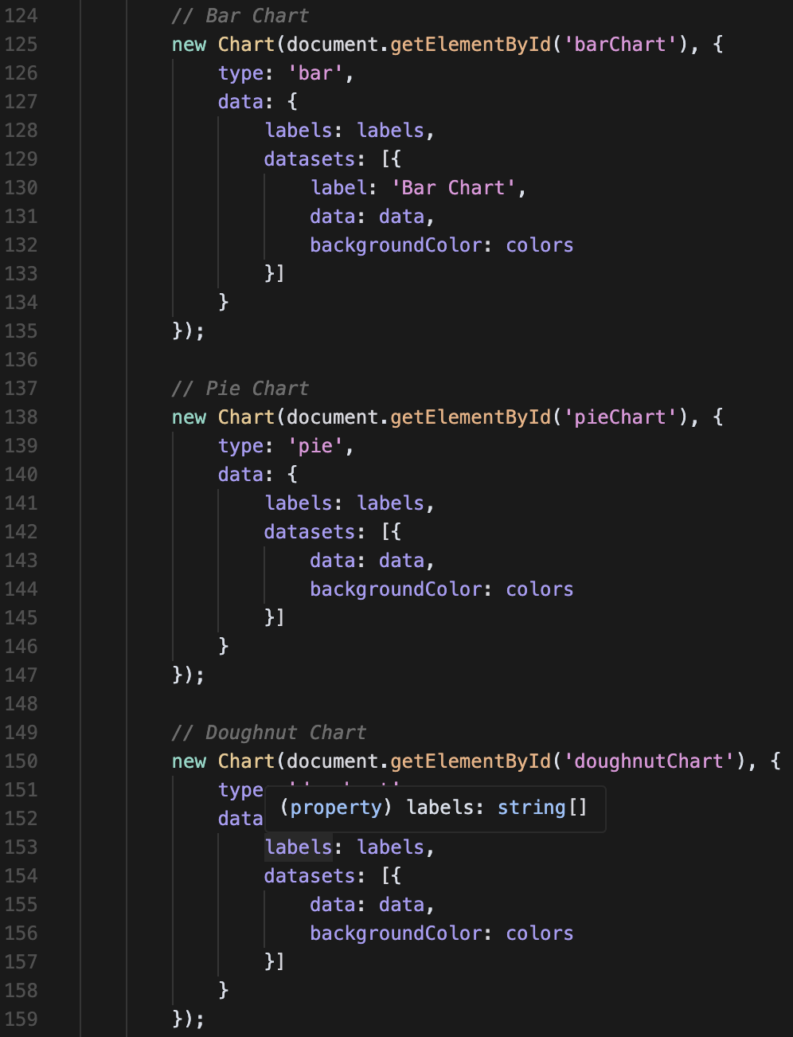
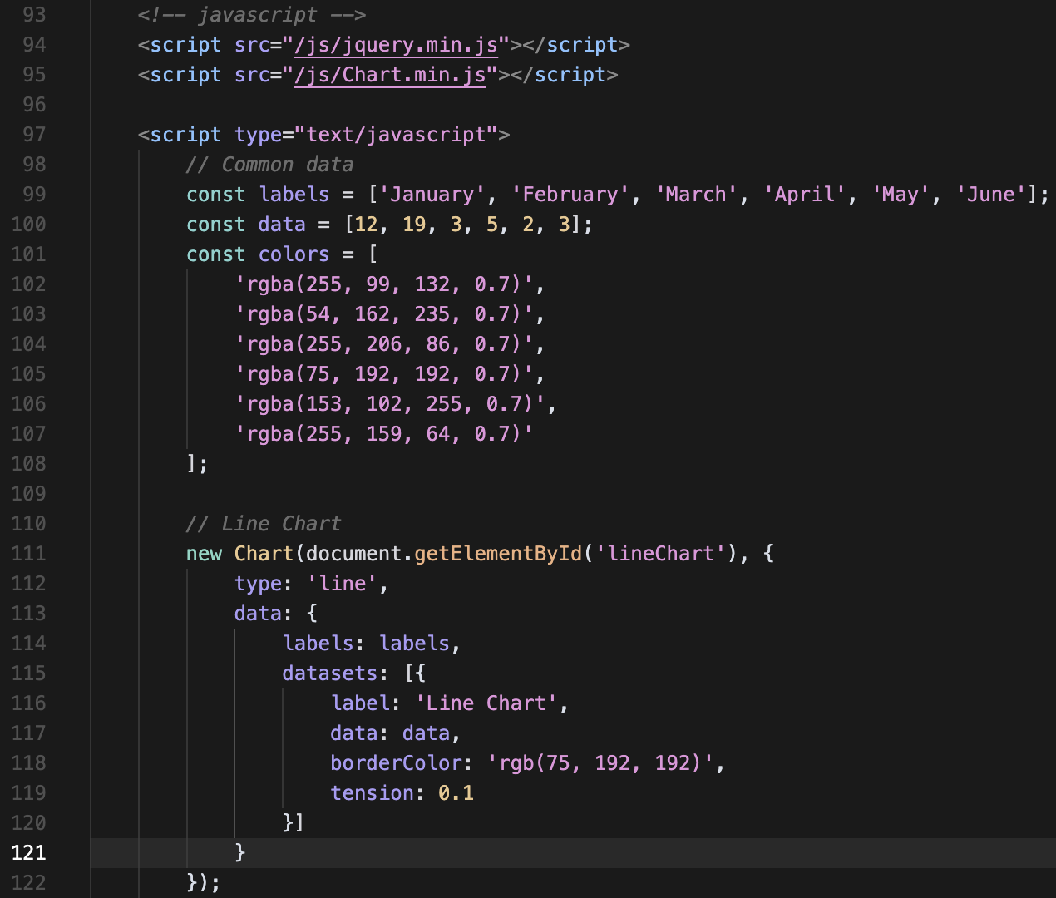
Code:

Slide 11
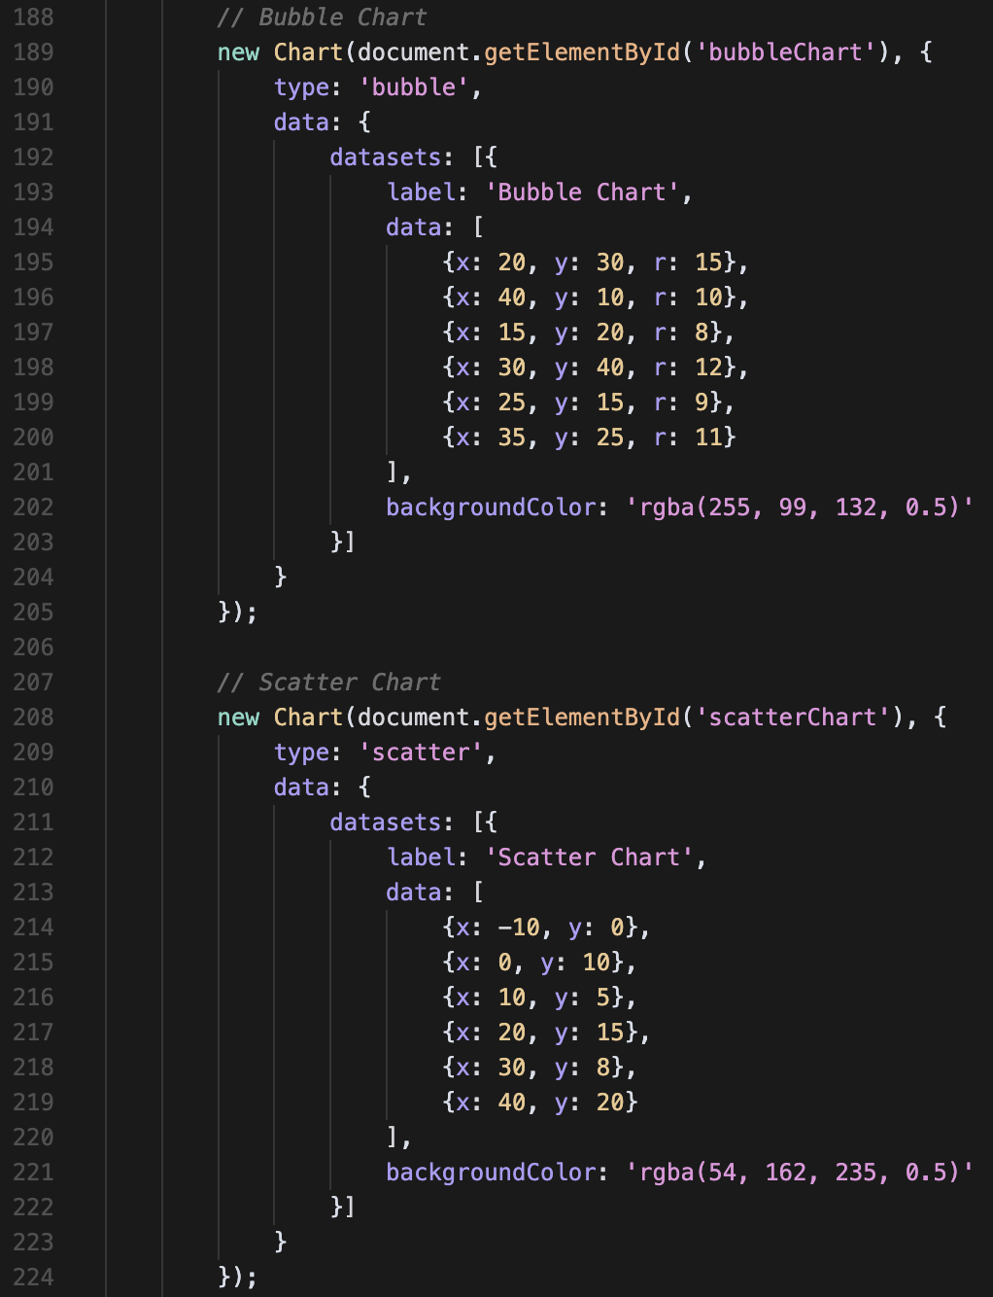
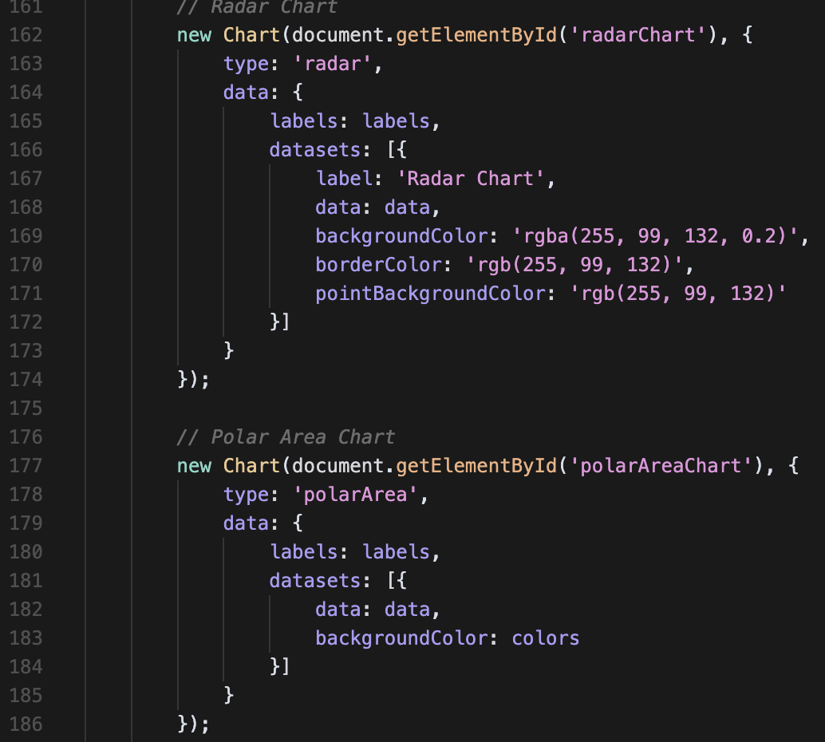
Code:

Slide 12
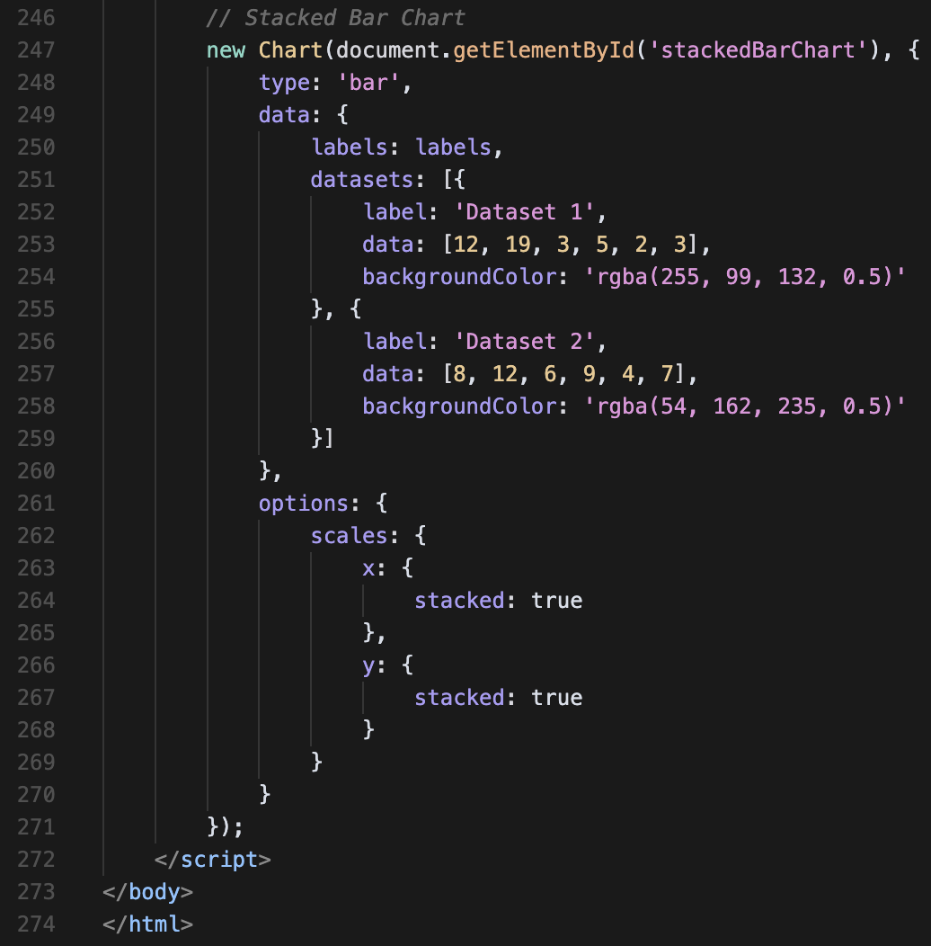
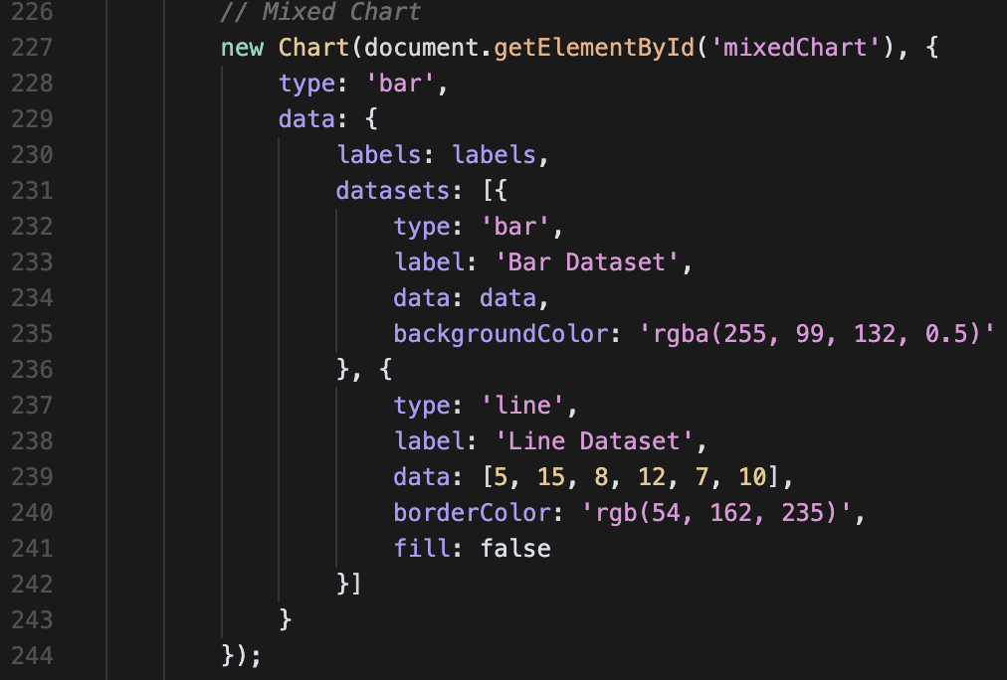
Code:

Slide 13
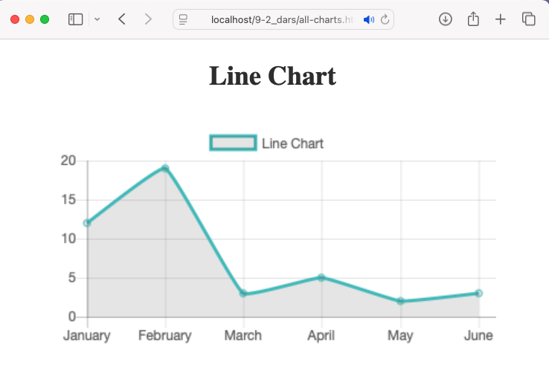

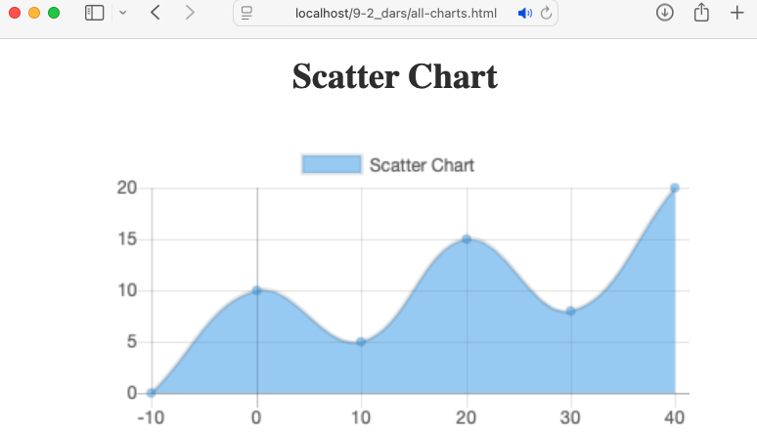
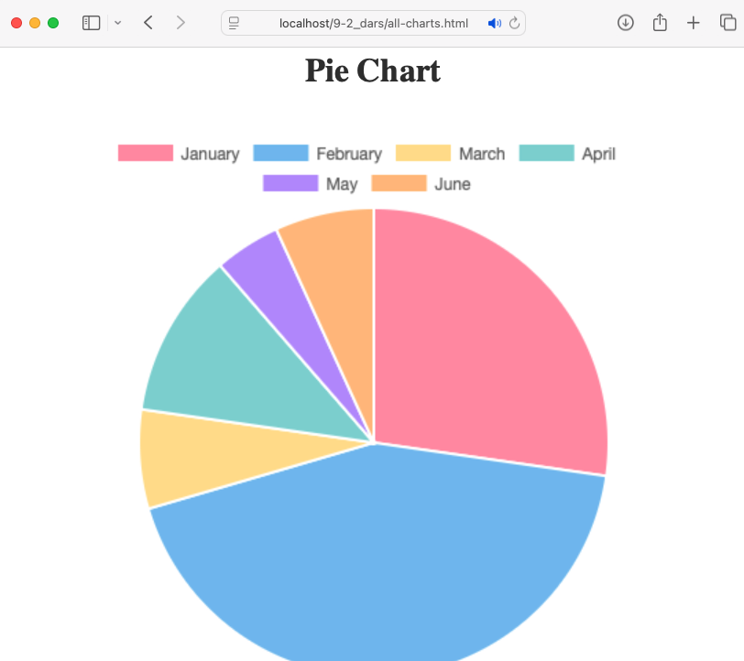
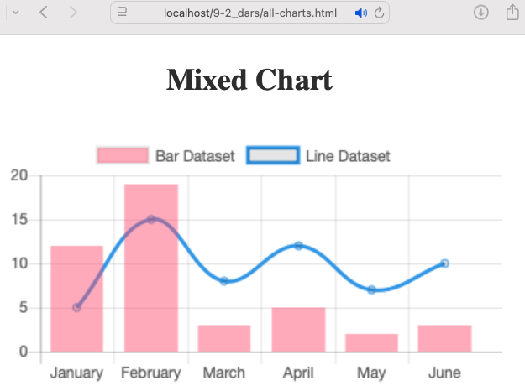
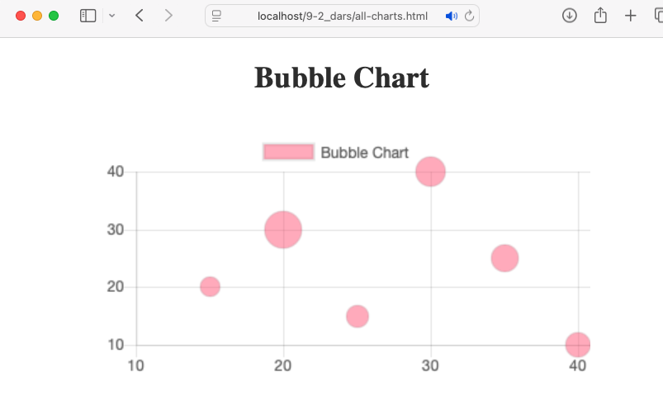

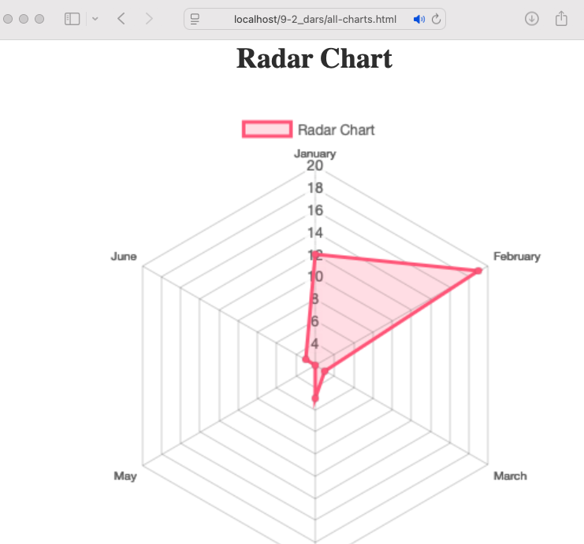
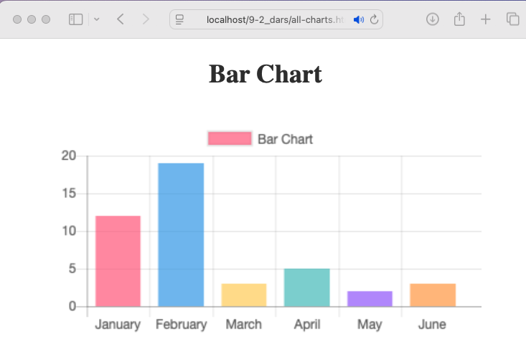
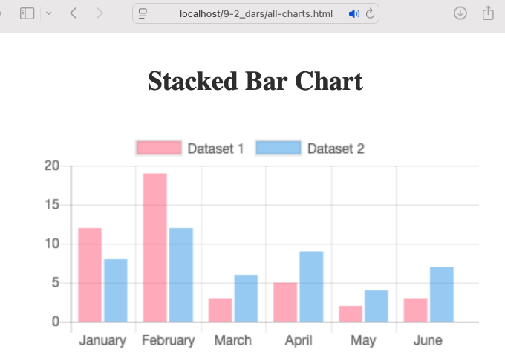
Results
d

Slide 14
Question 4:

Slide 15
Answer:
JavaScript functions are essential in web development because they allow developers to create reusable blocks of code that can perform specific tasks, making the code more organized and maintainable. They enable dynamic interactions on web pages, such as handling user events, manipulating the DOM, and making asynchronous requests to servers, which are crucial for creating interactive and responsive web applications.

Slide 16
Question 5:

Slide 17
Answer:
Database-powered websites are more useful than static ones because they can dynamically update and display content without requiring manual code changes. They enable efficient data storage, retrieval, and management, allowing for features like user authentication, personalized content, and real-time updates. Additionally, they support scalability and can handle large amounts of data, making them ideal for applications that need to grow and evolve over time.

